Slide 1

Lecture 2-3: Linear Predictors
Gonzalo De La Torre Parra, Ph.D.
Fall 2021

Slide 2
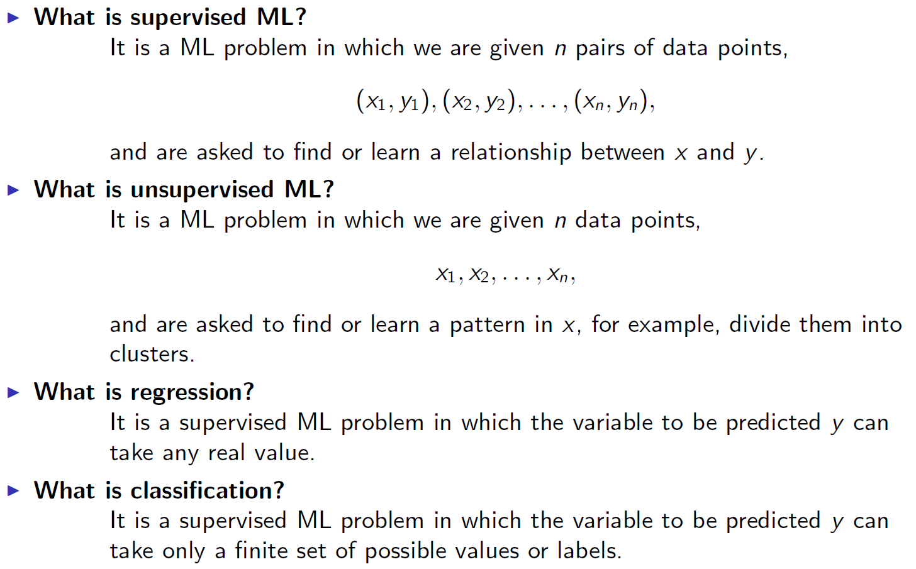
Quick Recap

Slide 3
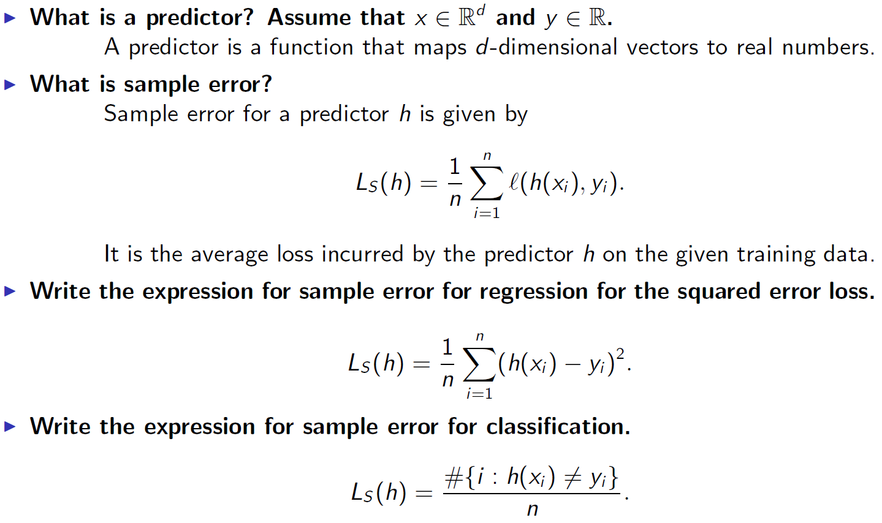
Quick Recap Cont.

Slide 4
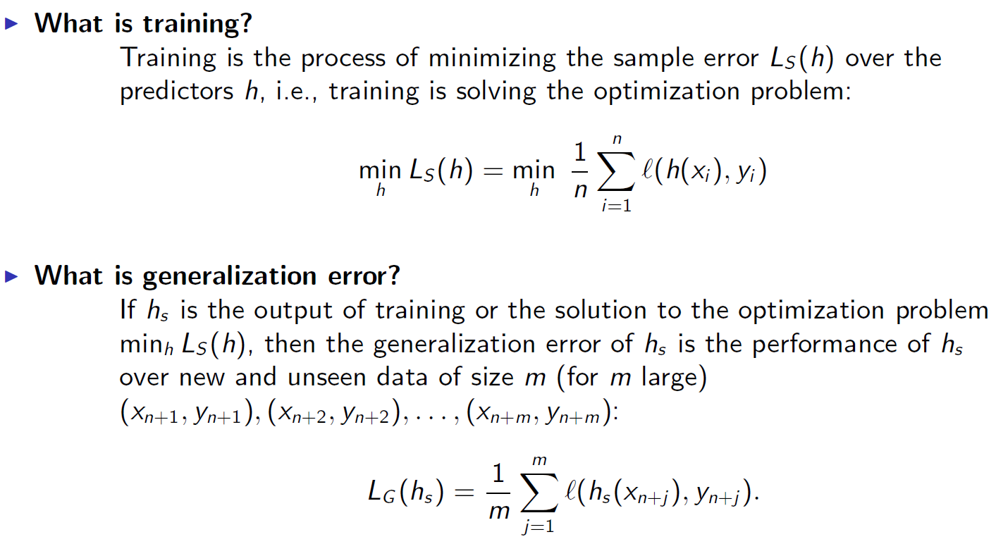
Recap Cont.

Slide 5
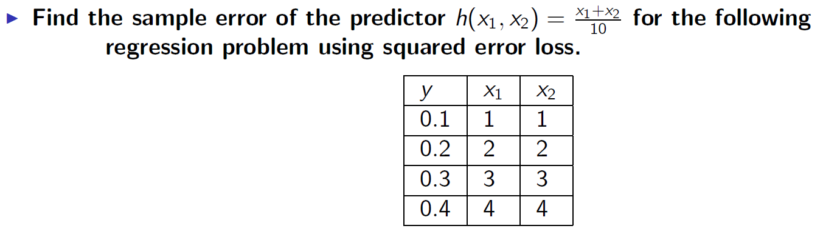
Quick Exercise

Slide 6
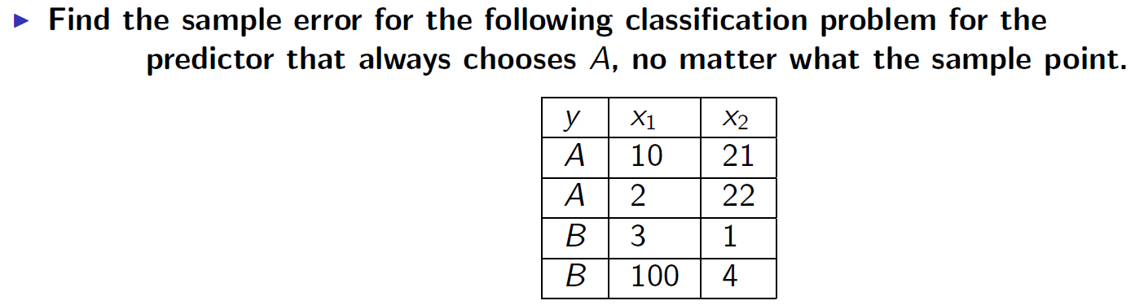
Quick Exercise

Slide 7
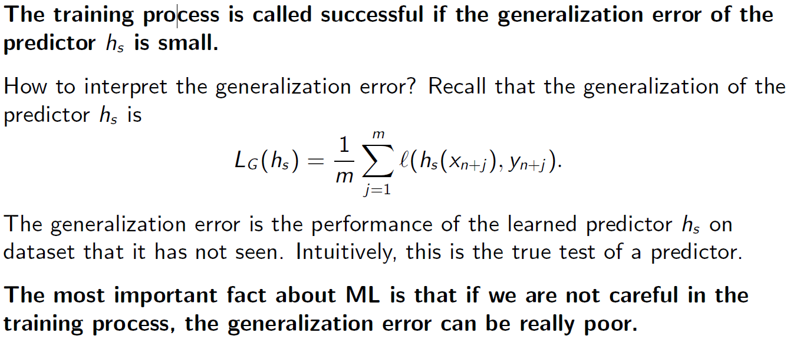
When is the Training Process called Successful?

Slide 8
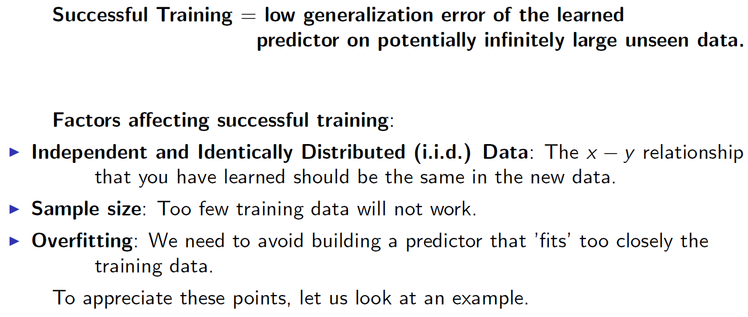
Factors Affecting Successful Training

Slide 9
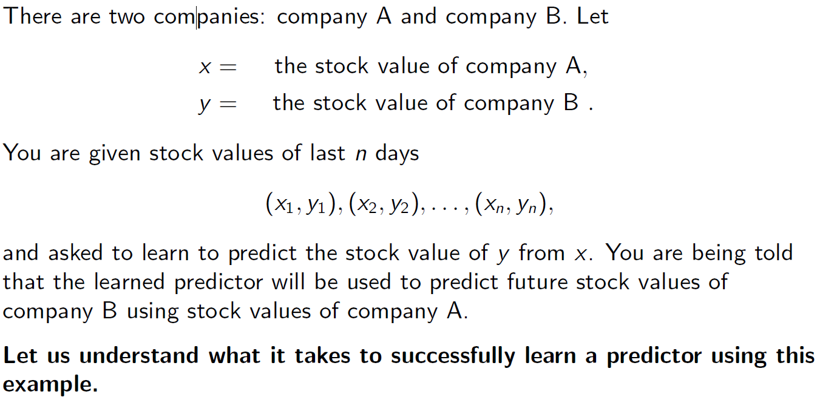
Predicting Financial Market

Slide 10
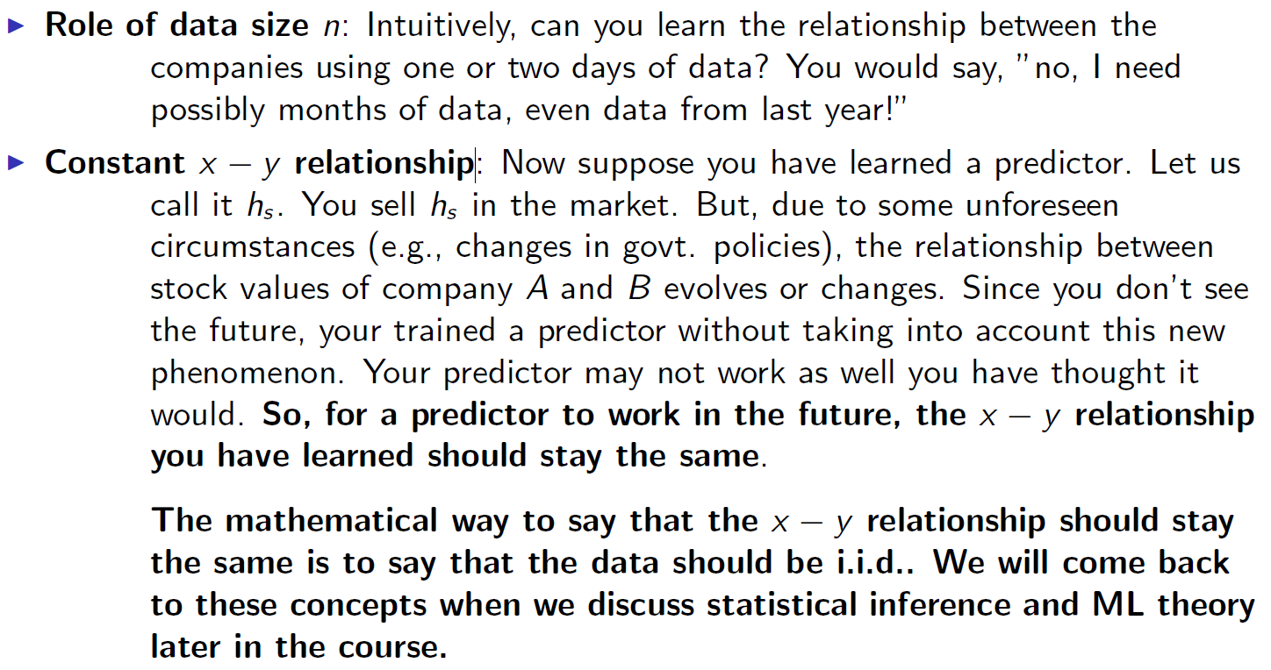
Predicting Financial Market

Slide 11
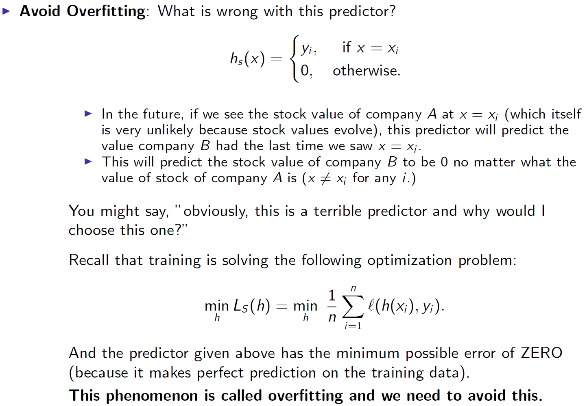

Slide 12
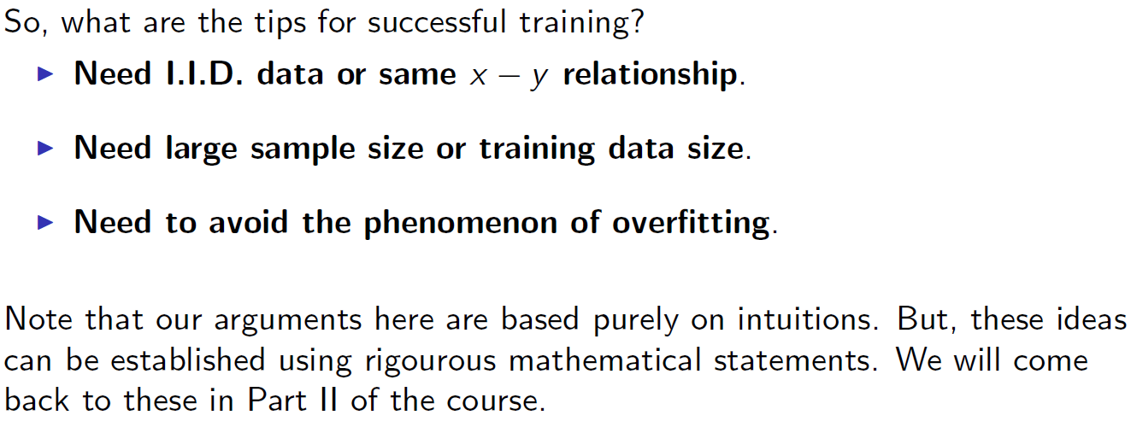
Tips for Successful Training

Slide 13
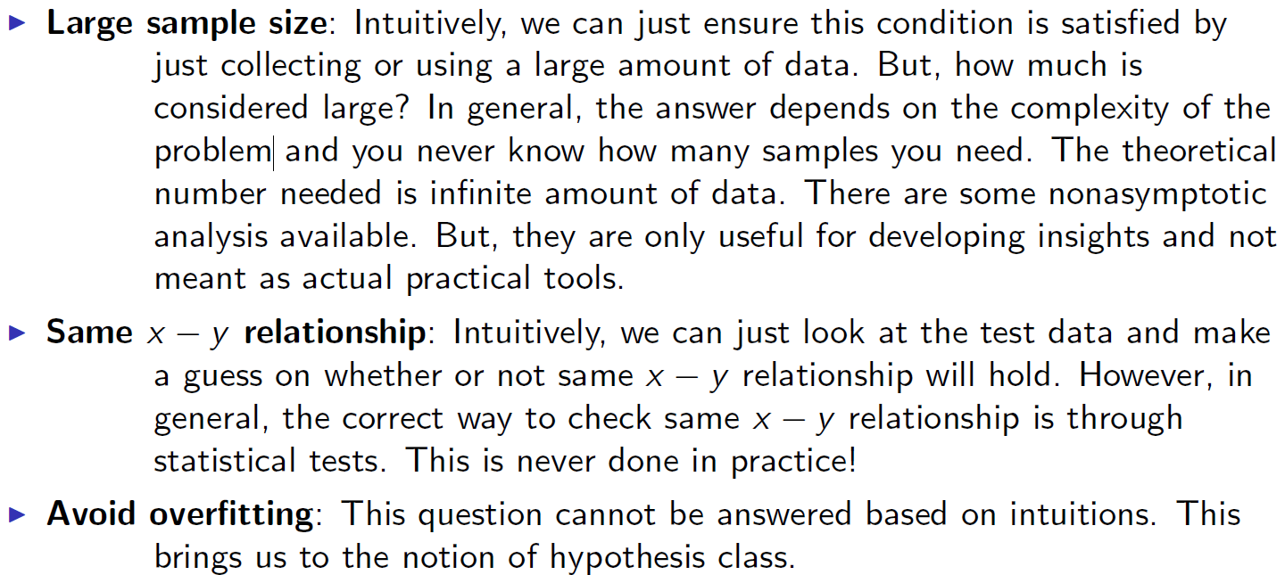
Tips for Successful Training: How do we make sure these conditions are satisfied?

Slide 14
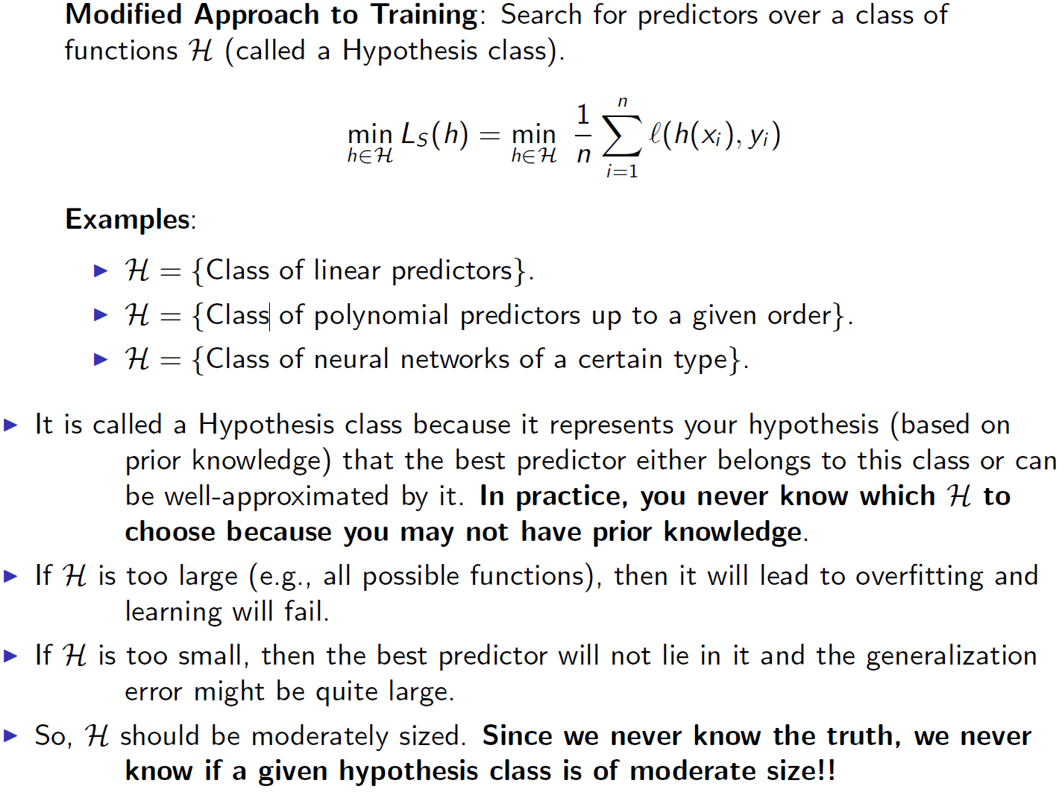
Hypothesis Class

Slide 15
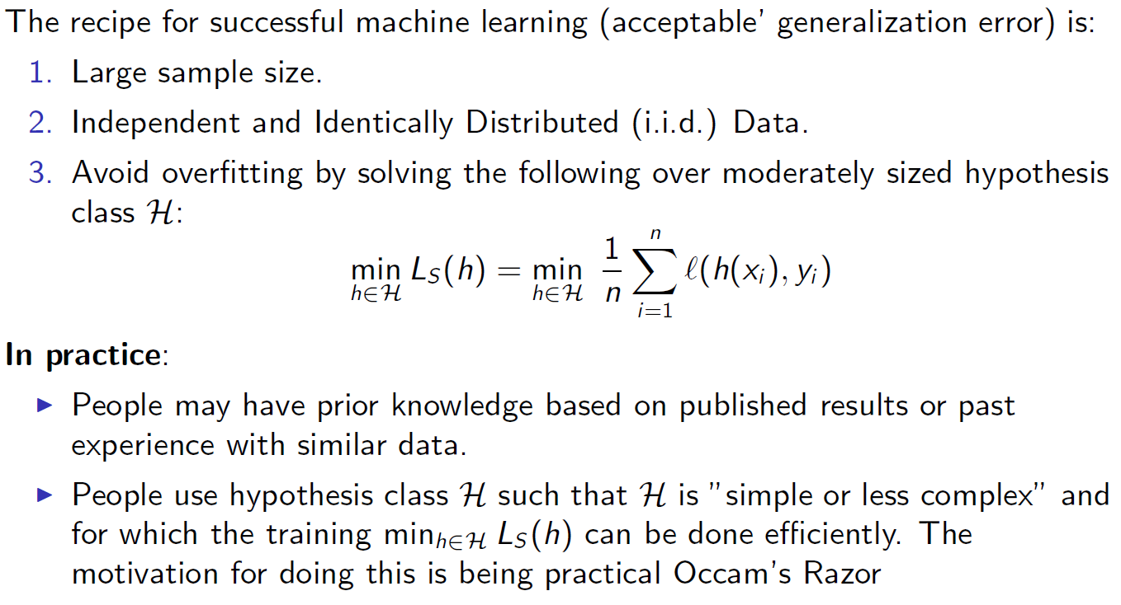
Recipe for Successful ML

Slide 16
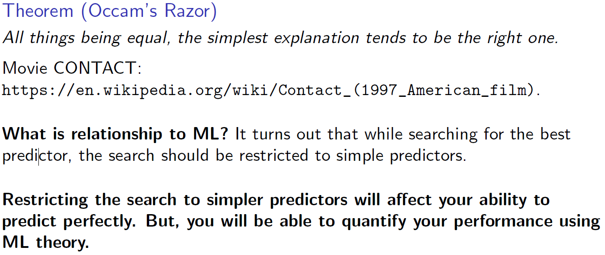
Occam's Razor

Slide 17
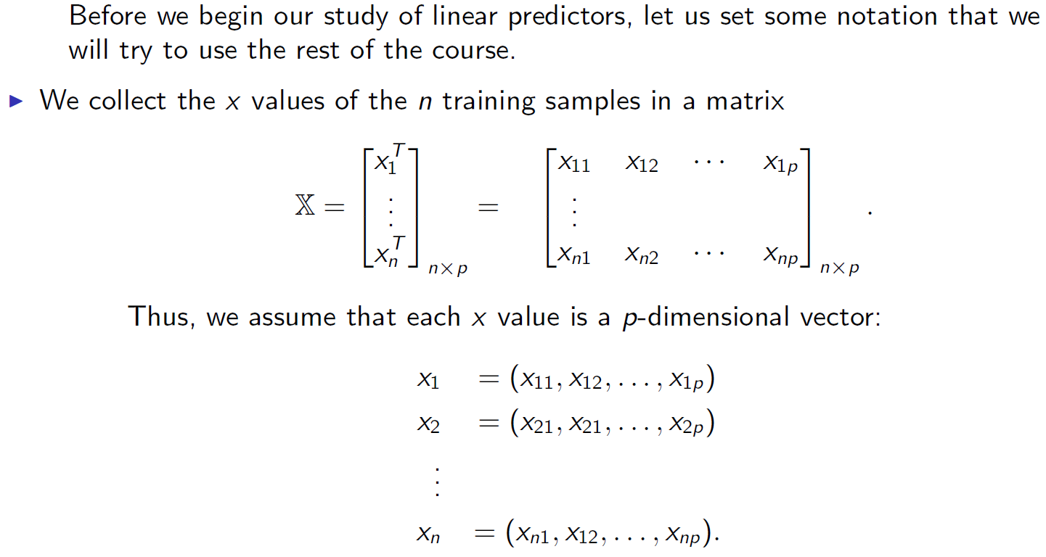
Linear Predictors: Notations

Slide 18
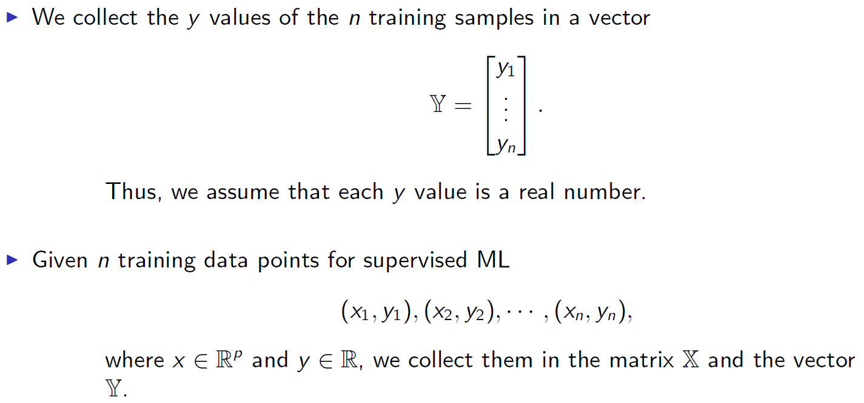
Linear Predictors: Notations

Slide 19
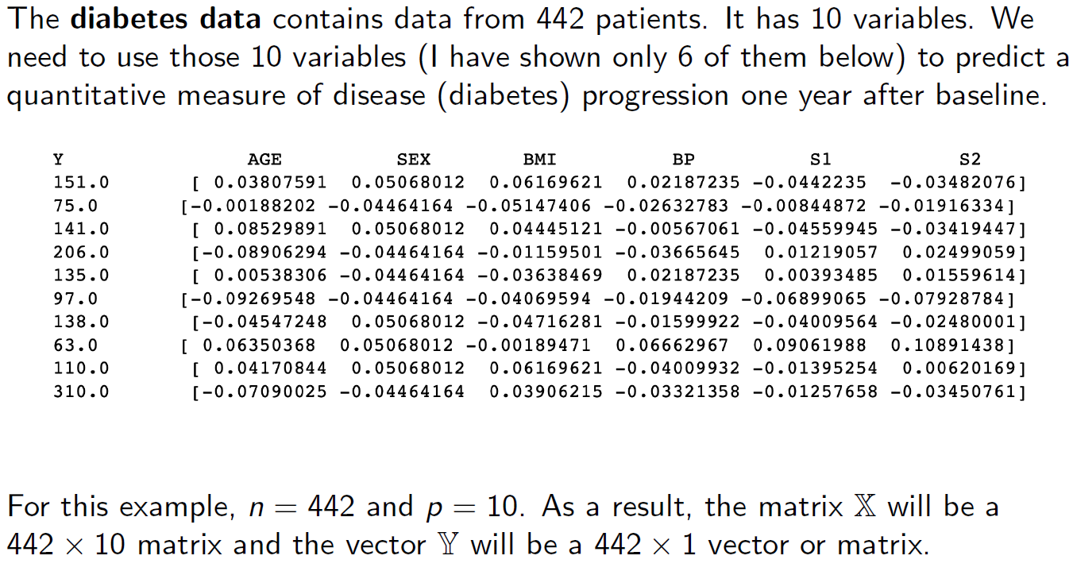

Slide 20
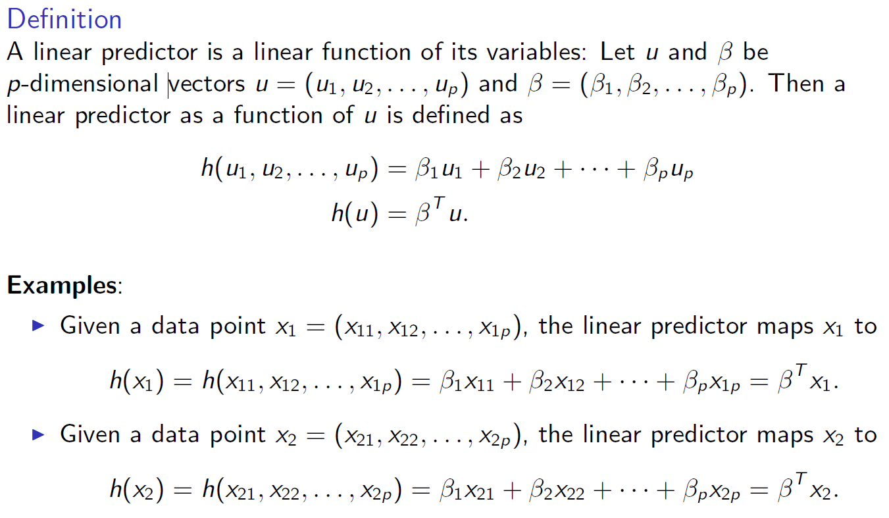
Linear Predictors

Slide 21
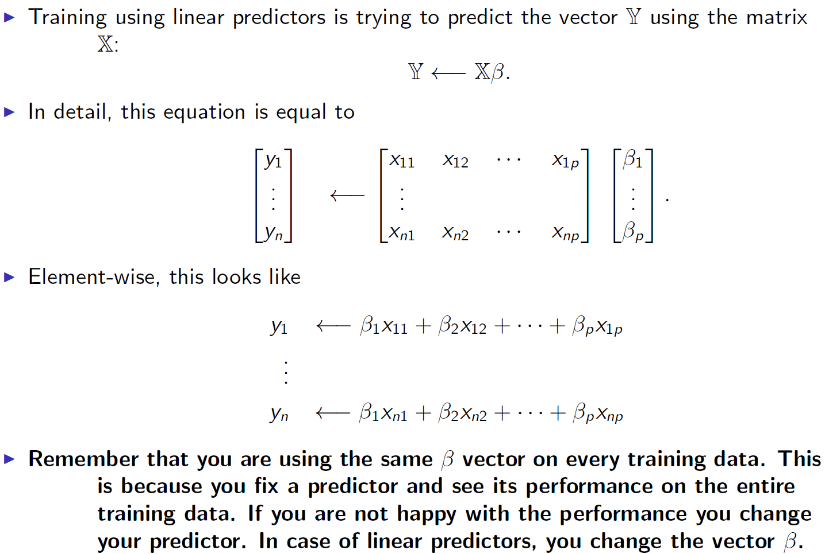

Slide 22
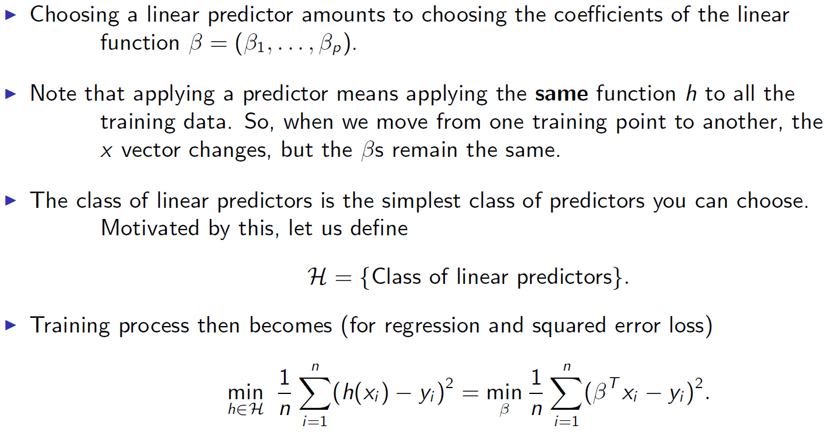
Hypothesis Class of Linear Predictors

Slide 23
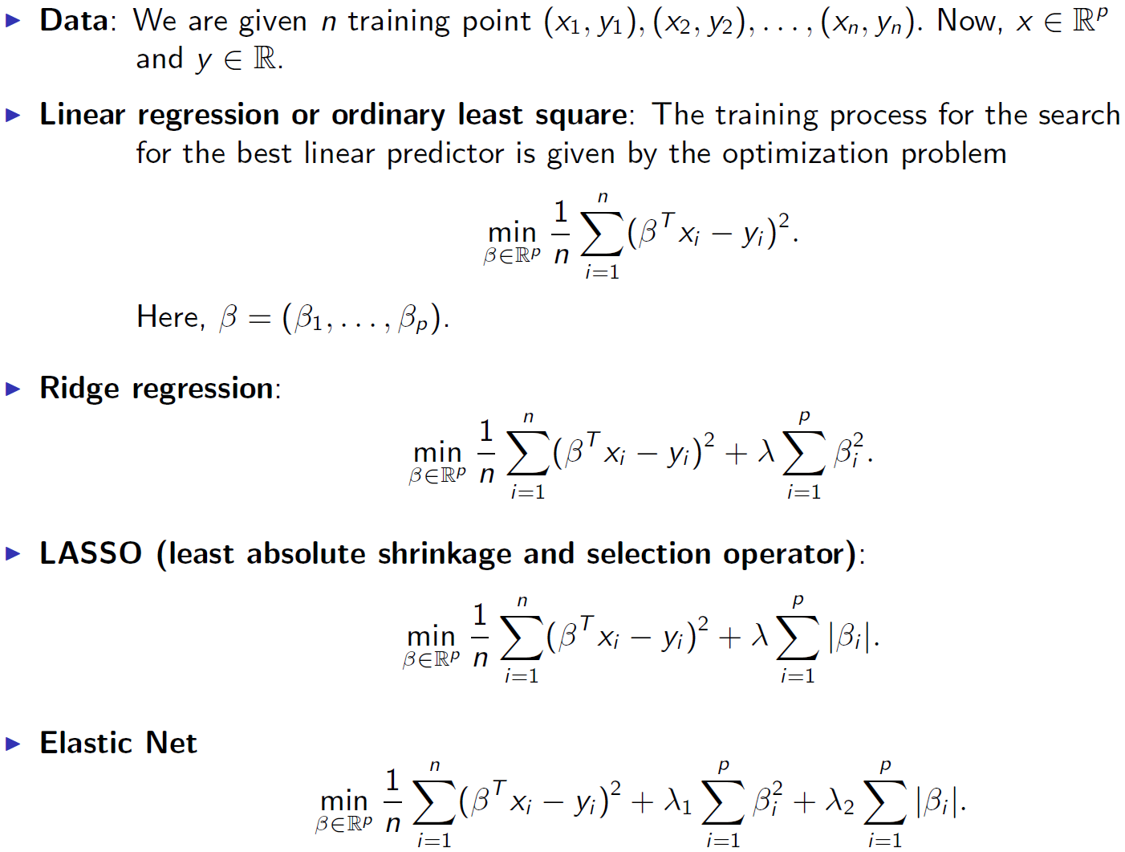
Linear Methods in Regression (Overview)

Slide 24
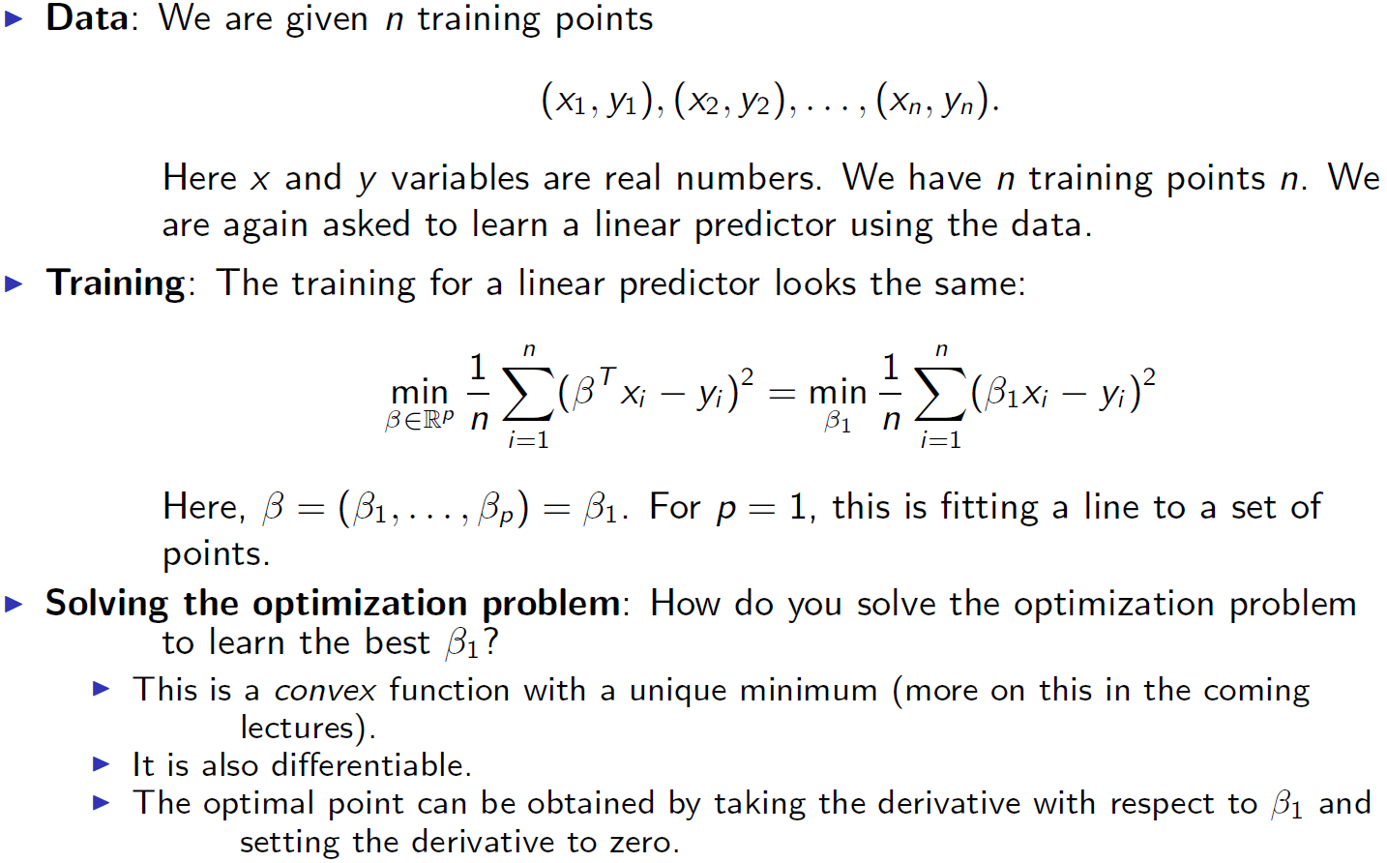
Linear Regression: Special Case of p = 1

Slide 25
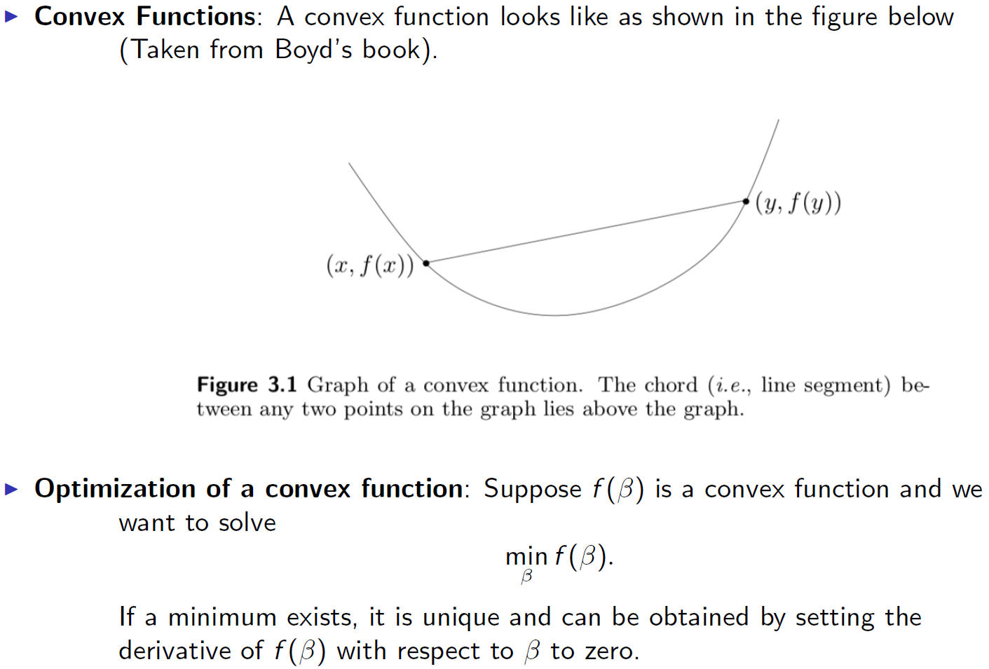

Slide 26
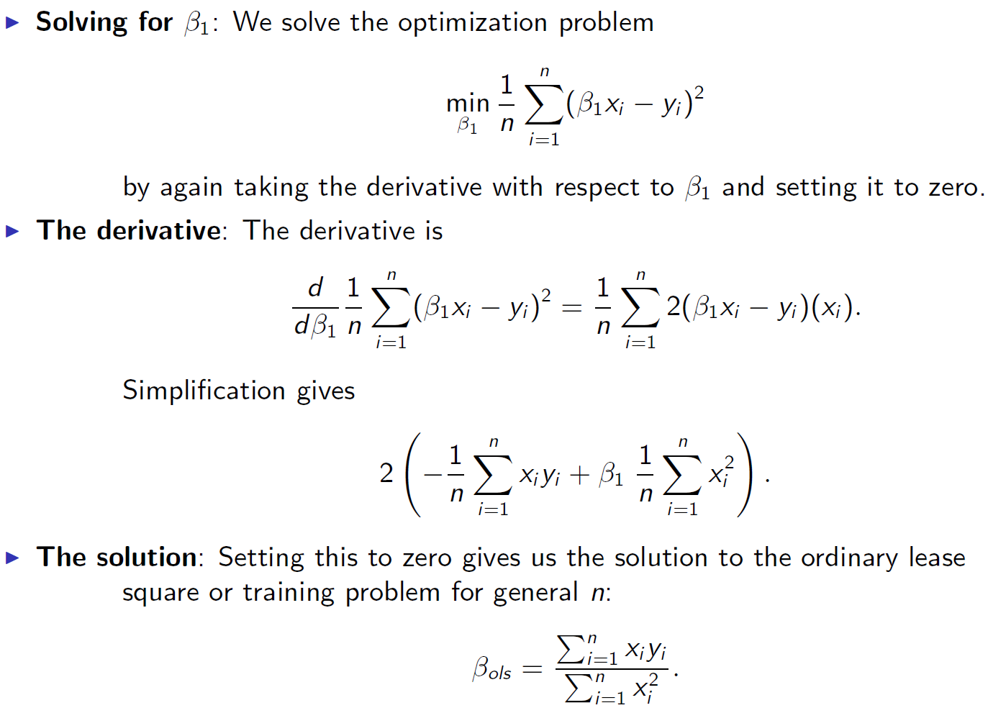

Slide 27
